Slide 1
This database is based on all preprint data from BioRxiv from 2013 to 2022. It Contains approximately 175,000 pieces of data in total. The following is an introduction to the content of each column of data.
By Zhili Hu

Slide 2
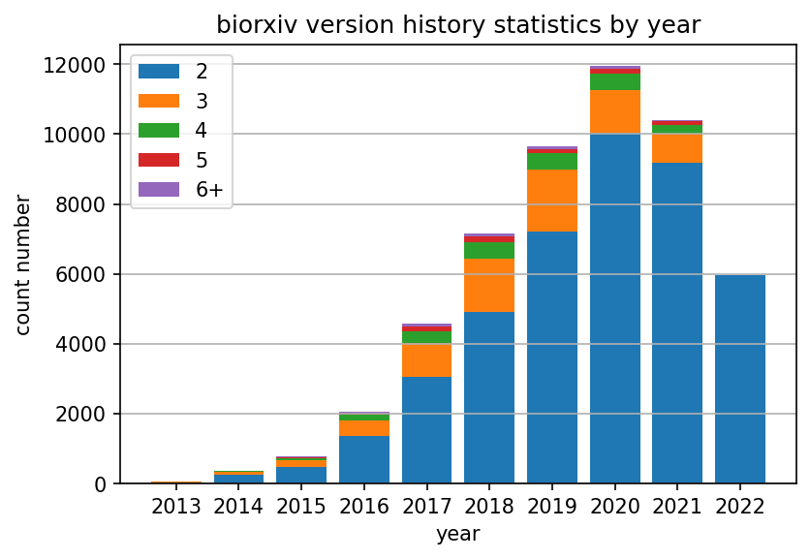
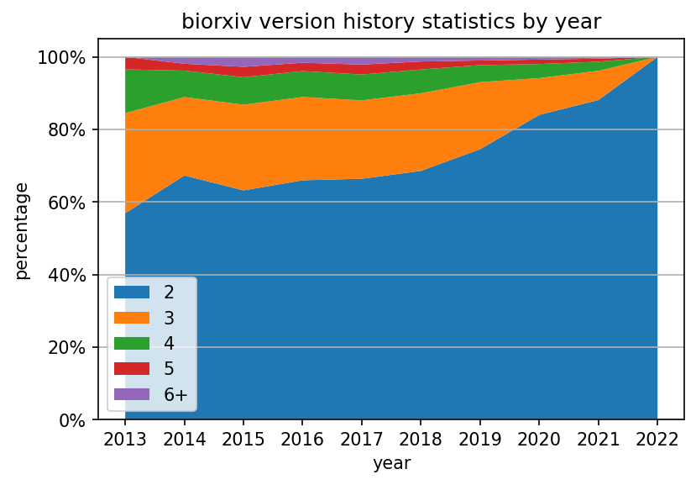
Doi: doi of the preprint. It is the main key of the database, and the doi of each preprint is unique.
first version year: The year of the first version of the preprint. Between 2013-2022.
first version date: Exact date of the first version of the preprint. Format is Year-Month-Date.
revisions: Number of preprint versions.
last version date: the date of the last version of the preprint.

Slide 3
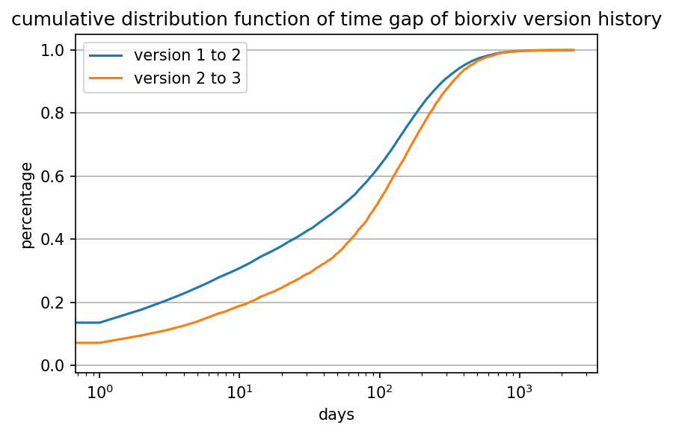
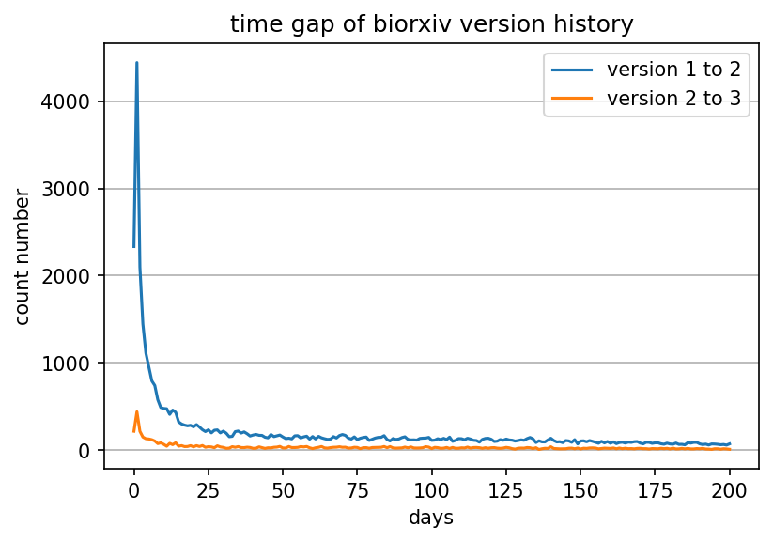

Slide 4
author count: number of authors.
category: Areas where preprints are released.
reference count: The number of citations of the preprint. When the number is 0, it is invalid data, which mostly appears in preprints in 2013. The overall proportion is small and does not affect the validity of the data.
referenced count: The number of times the preprint has been cited.
Comment number: Number of comments on the article.
all comment word count: The word count of all comments without stop-words.

Slide 5
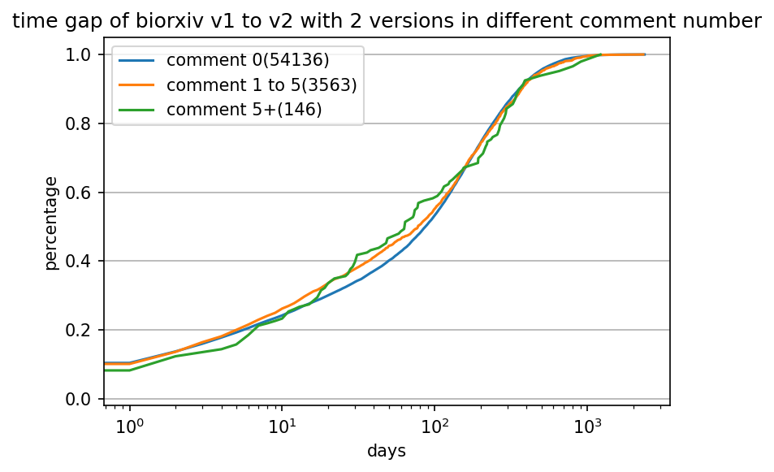
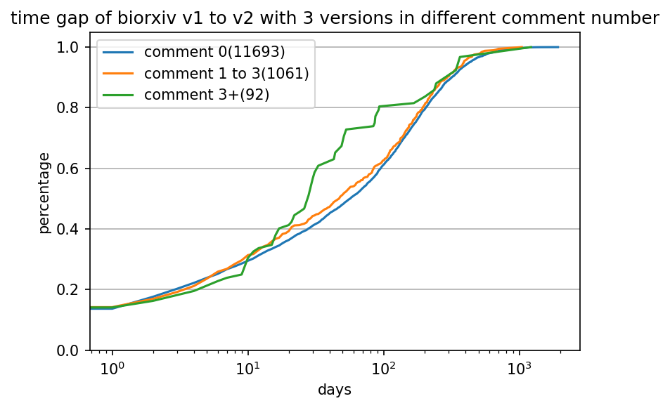
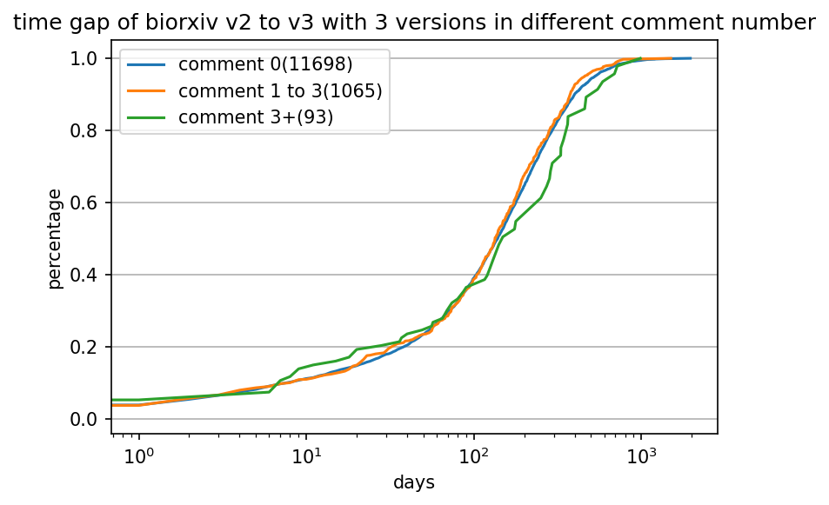
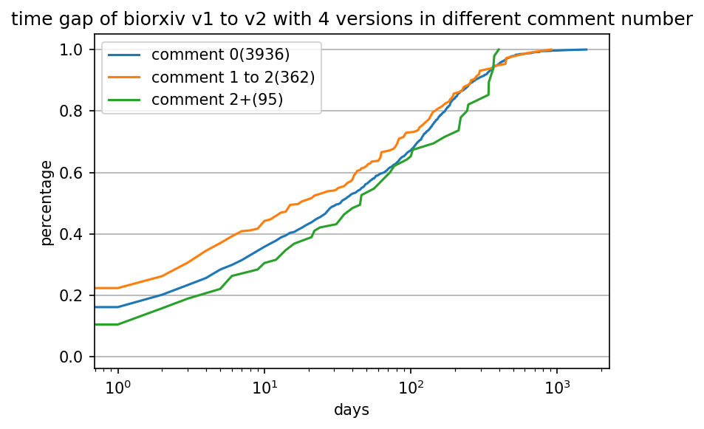
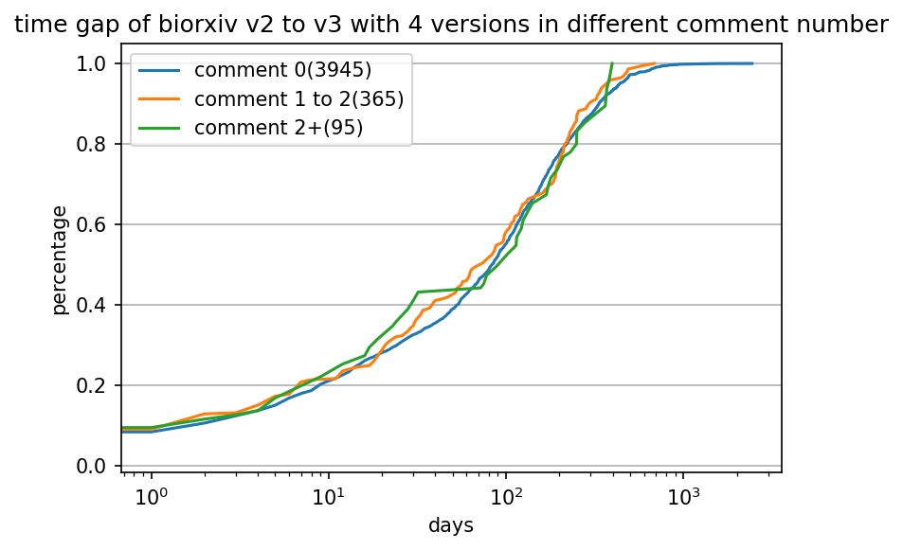
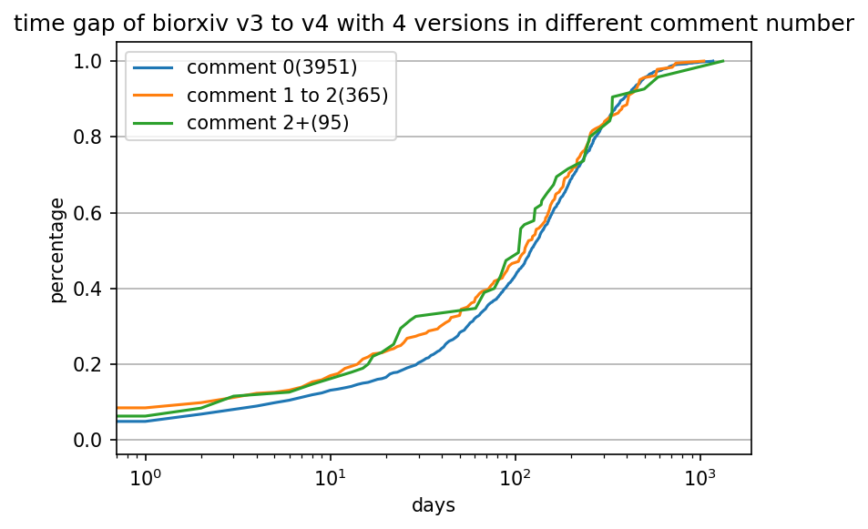
average comment day: The difference between the date of the review and the date the preprint was published is the number of comment day. This column counts the average comment day.

Slide 6


has author comment: Check if the author participated in the comment, usually by replying to the comment. If yes, the value is 1.
(10.1101/000927)

Slide 7
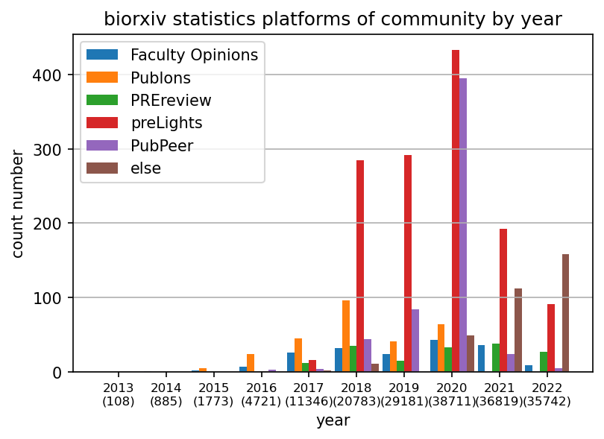
community review of (Faculty Opinions/ Publons/ PREreview/ preLights/ PubPeer/ Rapid Reviews Infectious Diseases/ Arcadia Science/ Other): These seven communities are the seven most dominant communities in community responses. When there is a community response to the preprint, the corresponding number in the column is 1. If the community is not among these 7, then other is 1.

Slide 8
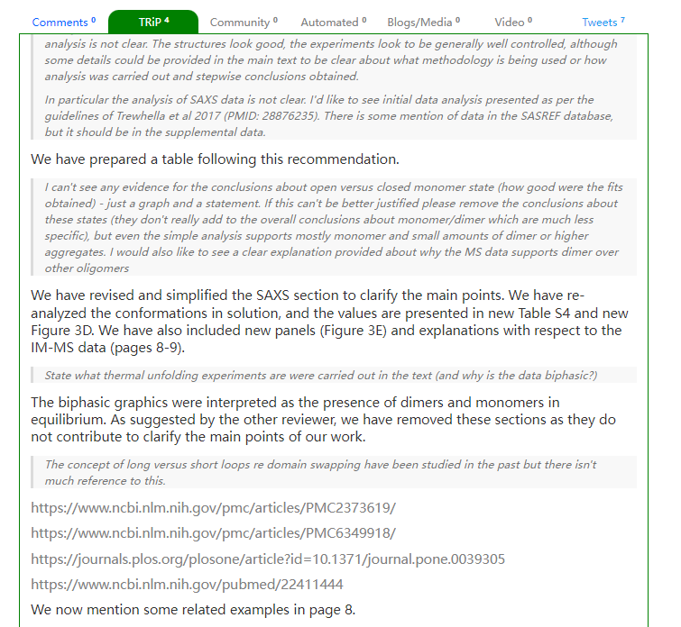
TRiP words count: Word count of all trip replies without stop-words.
TRiP link count: Number of links for all trip replies.
TRiP link: Links in all trip replies, separated by semicolons.
(10.1101/833319 )

Slide 9
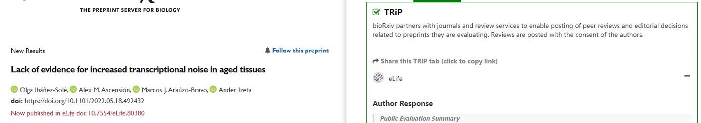
Published in TRiP journal: Check whether the preprint is published in the same journal as the trip review. If yes, then 1.
(10.1101/2022.05.18.492432)

Slide 10
publication date: The date this preprint was published. If empty, it is not published.
publication journal or conference: The name of the journal where the preprint was published.
IF journal 2019: The impact factor of the publishing journal. Since it changes every year, 2019 shall prevail (before the epidemic).
publication reference count: The number of citations of the published article.
publication be referenced count: The number of times the published article has been cited.
Publisher: publisher name of the published article.

